Slide 1
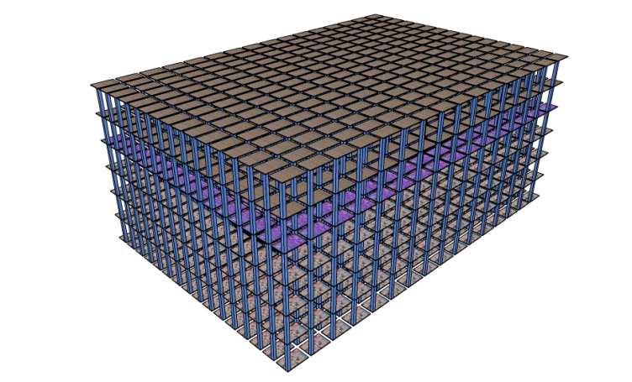
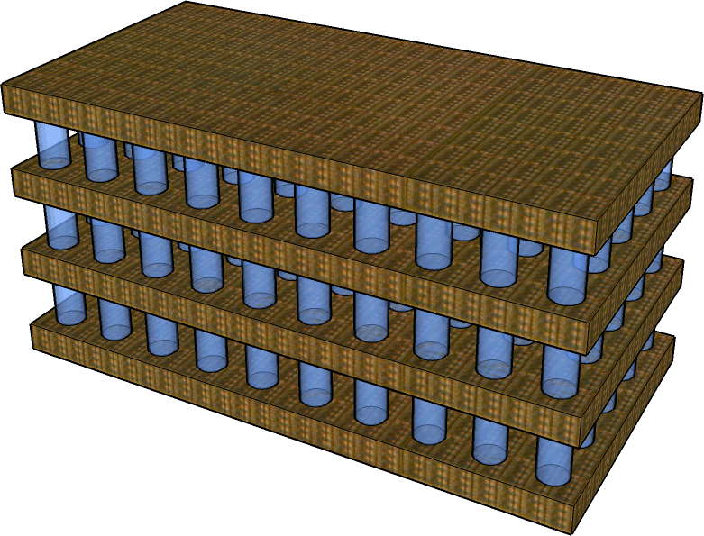
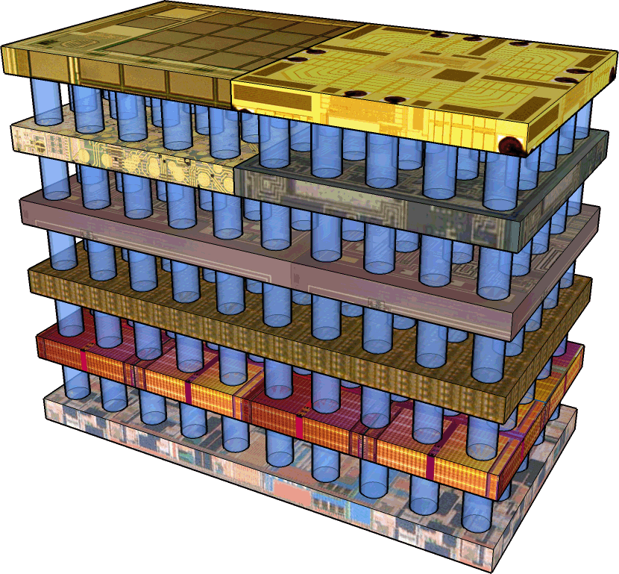
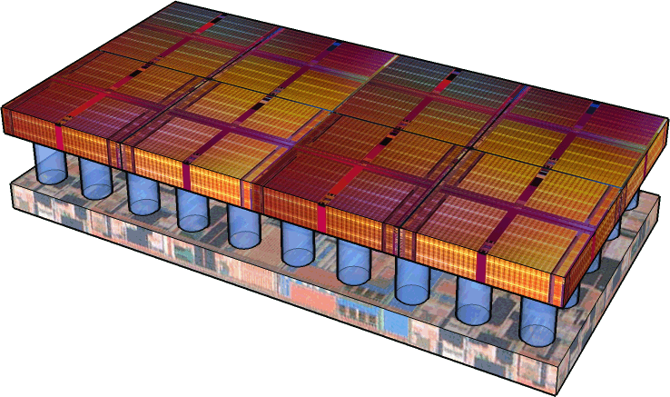
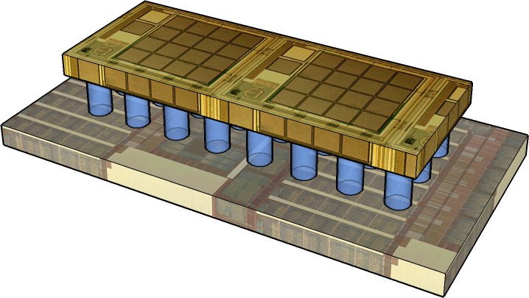
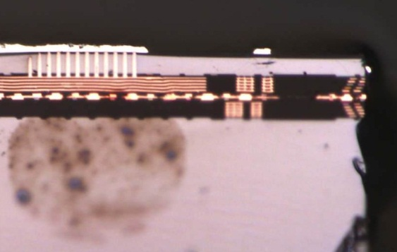
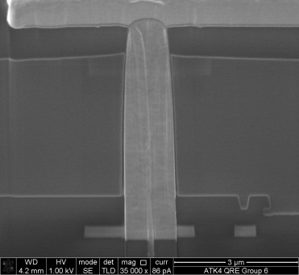
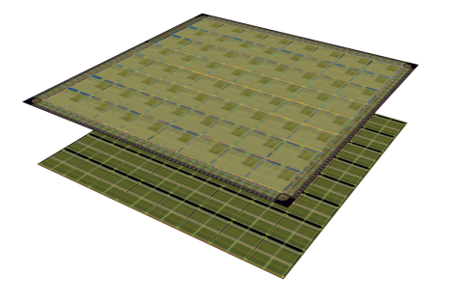
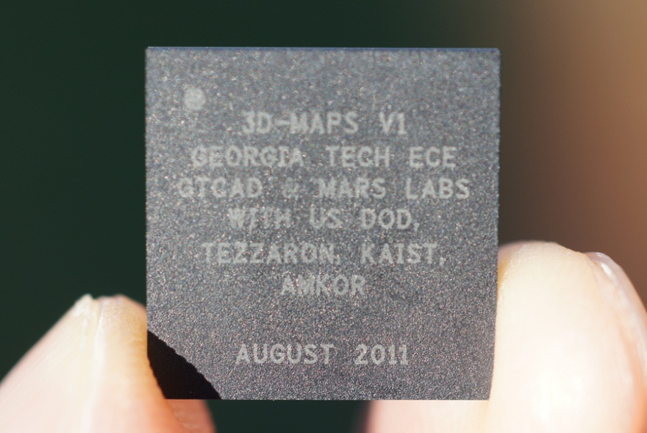

Global Built-In Self-Repair for 3D Memories with Redundancy Sharing & Parallel Testing
Xiaodong Wang
∗ Dilip Vasudevan
Hsien-Hsin Sean Lee
University of College Cork∗ Georgia Tech

Slide 2
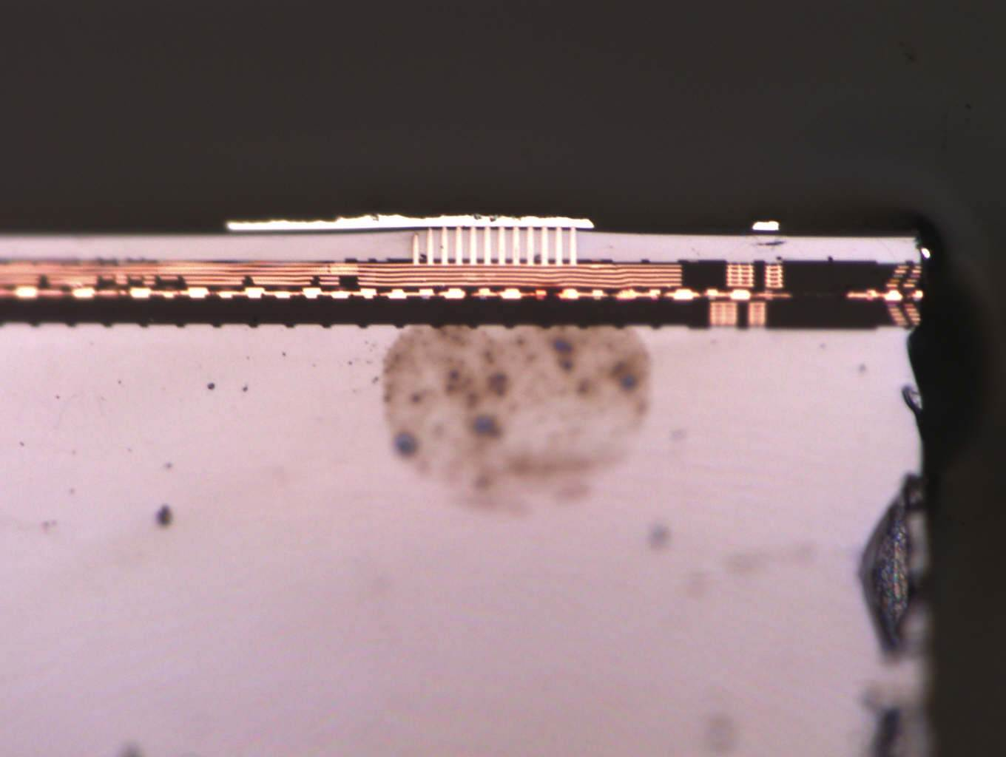
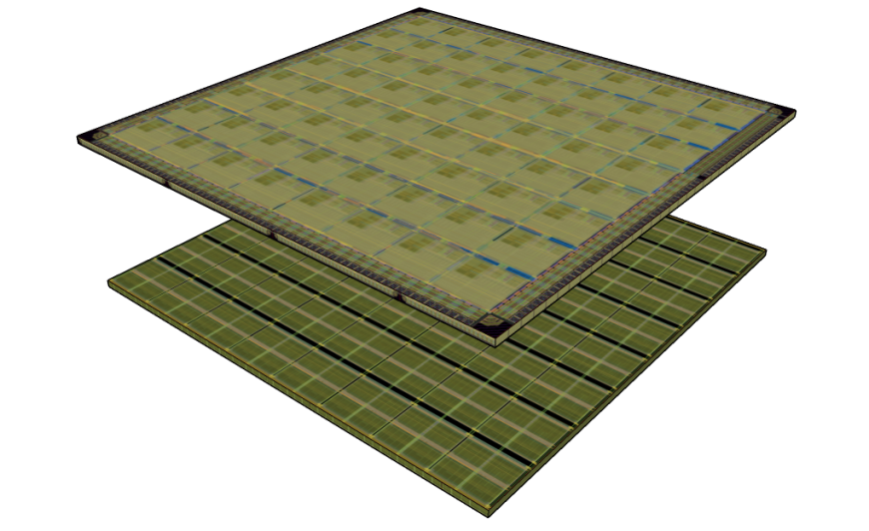
3D Memory Architecture
High Density
Low latency
Energy Efficiency
High Bandwidth
F2F via
TSV
Heterogeneous Integration
Core
Memory
[3D-MAPS, ISSCC 2012]

Slide 3
Traditional 2D Built-In Self-Repair
Decoder Redirection BISR
Fault Cache BISR
Decoder redirection
Non-shareable local redundancy
Complicated routing
Serial testing

Slide 4

Two Goals of Global 3D BISR Memory Architecture
Shareable Global Redundancy
True 3D sharing: No waste across layers
Redundancy to be shared by all memory layers
Parallel Testing
Simultaneous built-in self-test (BIST) across all 3D memory layers
Leverage the use of TSV

Slide 5
Our Contribution 3D Global Essential Spare Pivoting (3D-GESP) algorithm for 3D Memory Global ESP + 3D BISR

Slide 6
Global ESP (GESP)
GESP = Global + MESP[TVLSI’10]
Shareable global redundancy
High resource utilization rate
GESP
Differentiate spare row & column at run time
Replacement starts at any arbitrary location
MESP
Differentiate spare row & column at design time
Replacement starts at aligned boundary

Slide 7
3D BISR
Mem Layer 0
Mem Layer 1
Shared BISR Layer
Simplified routing via TSVs
FSM control
Simultaneous testing on all memory layers
Dedicated layer with global redundancy, BISR control logic, and auxiliary circuits

Slide 8
3D BISR Timing Diagram
Faulty
cycle 1 2 3 4 5
Memory layer 0
HiZ
0
1
Faulty
Memory layer 1
HiZ
0
1
BISR Layer
1
0
Waiting

Slide 9
3D BISR Timing Diagram
Repair
cycle 1 2 3 4 5
Memory layer 0
00
0
1
1
Faulty
Memory layer 1
HiZ
1
0
1
BISR Layer
00
1
1
Accept info

Slide 10
3D BISR Timing Diagram
No Fault
cycle 1 2 3 4 5
Memory layer 0
HiZ
0
0
Repair
Memory layer 1
01
0
1
1
BISR Layer
01
1
1
Accept info

Slide 11
3D BISR Timing Diagram
No Fault
cycle 1 2 3 4 5
Memory layer 0
HiZ
0
0
0
No Fault
Memory layer 1
HiZ
0
0
0
BISR Layer
0
Alloc GRU

Slide 12
We now have Parallel Testing but still …. Serial Layer-by-Layer Reporting

Slide 13
3D Redundant Cylinder for Repair
Add redundant cylinder in BISR layer
Row, column, and cylinder replacement
Uncommon to have > 1 fault on a cylinder

Slide 14
Cylinder Replacement Timing Diagram
Faulty
cycle 1 2 3 4
Memory layer 0
HiZ
0
1
1
Faulty
Memory layer 1
HiZ
0
1
1
Faulty
Memory layer 2
HiZ
0
1
1
BISR Layer
1
0
Waiting

Slide 15
Cylinder Replacement Timing Diagram
Repair
cycle 1 2 3 4
Memory layer 0
00
1
1
1
Faulty
Memory layer 1
HiZ
0
1
1
Faulty
Memory layer 2
HiZ
0
1
1
BISR Layer
00
1
0
Accept info

Slide 16
Cylinder Replacement Timing Diagram
No Fault
cycle 1 2 3 4
Memory layer 0
HiZ
0
0
0
Repair
Memory layer 1
01
1
1
1
Faulty
Memory layer 2
HiZ
1
1
1
BISR Layer
01
1
0
Alloc cylinder

Slide 17
Cylinder Replacement Timing Diagram
No Fault
cycle 1 2 3 4
Memory layer 0
HiZ
0
0
0
No Fault
Memory layer 1
HiZ
0
0
0
No Fault
Memory layer 2
HiZ
0
0
0
BISR Layer
0
1
Waiting

Slide 18
Evaluation Baseline
8-layer 3D memory
1024×1024×8-bit per layer
Clustered fault model [Stapper, TCAD‘89]
Assume certain susceptibility parameters of fabrication process [Lu et al., TVLSI’10]
23.5 faults per layer

Slide 19
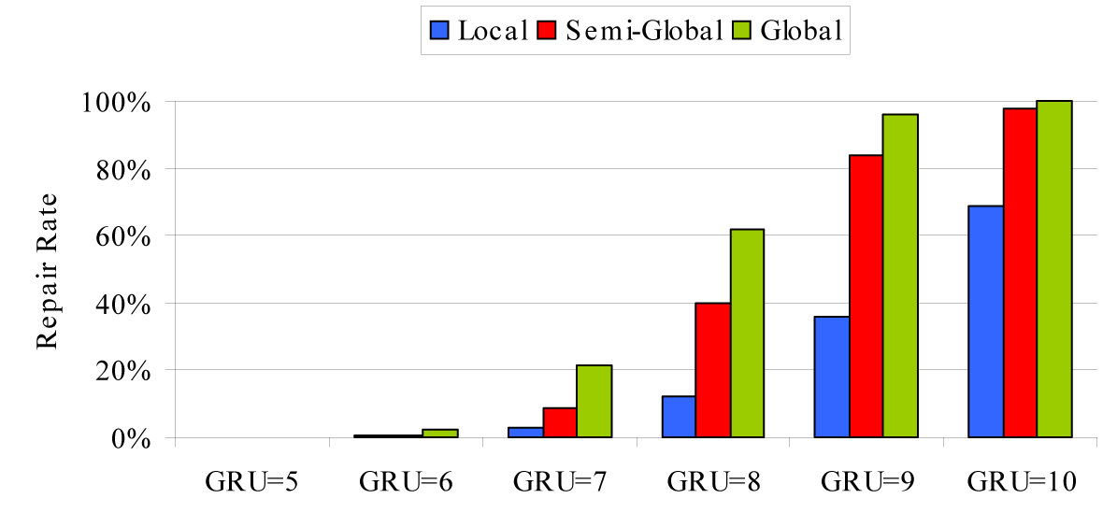
Local vs. Global Redundancy
Local: dedicated, non-shareable redundancy to each layer
Semi-global: Shareable within a 4-layer group, non-shareable across groups
Global: Shareable redundancy across all memory layers
27% higher repair rate over Local, 8.6% over Semi-Global.
Notes:
As is shown in the graph, the global scheme achieves 27% higher repair rate than the Local scheme on average (59.9% maximum improvement for GRU=8 on each layer). Compared with the Semi-global scheme, our Global scheme has 8.6% improvement for the repair rate, with a maximal improvement of 22.3%.

Slide 20
3D BISR Comparison: GESP vs. MESP
Grid=4
Grid=8
Grid=16
Grid=32
Grid=64
Grid=128
Grid=256
Grid=512
Grid: The width (x 8bits) of a row/column that a GRU can replace
8.3% improvement (up to 27.6%)

Slide 21
Conclusion
Global Redundancy Sharing for 3D Memory
New 3D Cylinder Repairing Structure
8.3% Higher Repair Rate over MESP
Parallelized BISR Procedure
27% Higher Repair Rate over Local Scheme

Slide 22


That’s all, Folks !
Georgia Tech
ECE MARS Lab
http://arch.ece.gatech.edu

